Slide 1
FOOD AND NUTRIENTS
By class 2C/2D
Notes:
1

Slide 2
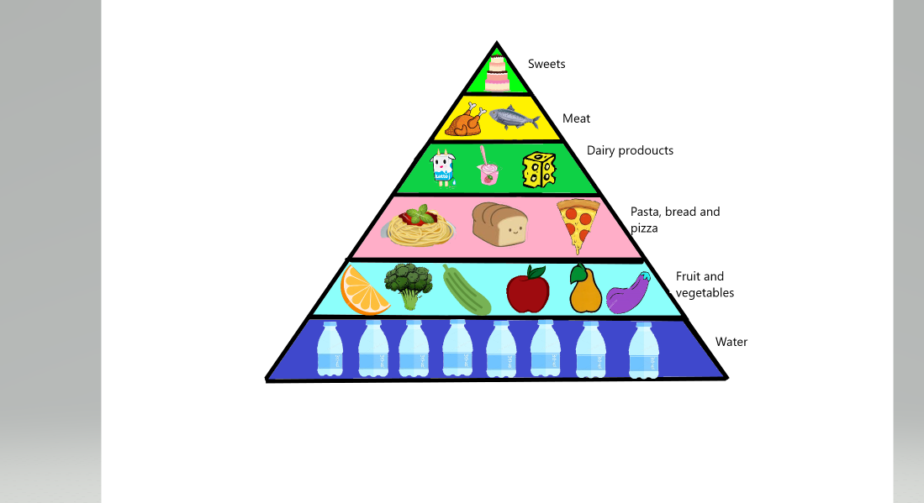
FOOD PYRAMID
Notes:
2

Slide 3

Nutrients
Notes:
3

Slide 4
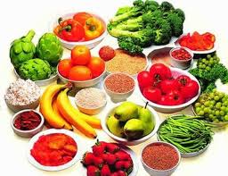
A nutrient is a substance used by an organism to survive, grow, and reproduce. Essential nutrients cannot be synthesized within the cell and must be present in the food.
There are four functions:
plastic function carried out by protein, fats and minerals
energy functions carried out by carbohydrates, fats and proteins
protective functions carried out by proteins and minerals
regulatory functions carried out by water, proteins, minerals and vitamins

Slide 5
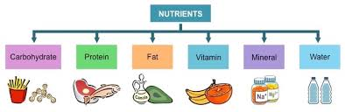
There are six essential nutrients that our body must have in order to work correctly:
CARBOHYDRATES
FATS
PROTEIN
VITAMINS
MINERALS
WATER

Slide 6
Carbohydrates
Key points
They are one of the four major macronutrients.
They provide a significant amount of fuel to the human body.
However, if carbohydrates are not properly digested and absorbed, they cannot perform their essential functions.
There are three main types of carbohydrates: starches, sugars and dietary fiber.
Notes:
6

Slide 7
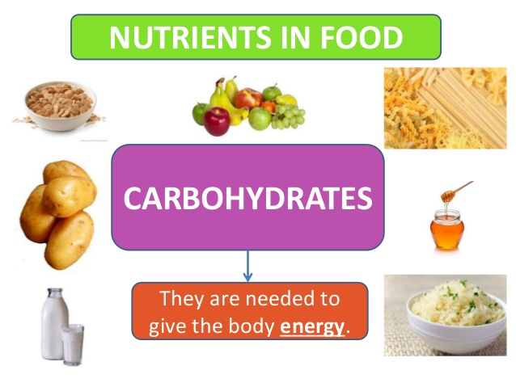
Notes:
7

Slide 8
Protein
Key points
Proteins are large, complex molecules that play many critical roles in the body.
They do most of the work in cells and are required for the
structure, function, and regulation of the body’s tissues
and organs.
Proteins are made up of hundreds or thousands of smaller
units called amino acids, which are attached to one
another in long chains.
There are 20 different types of amino acids that can be combined to make a protein
Notes:
8

Slide 9
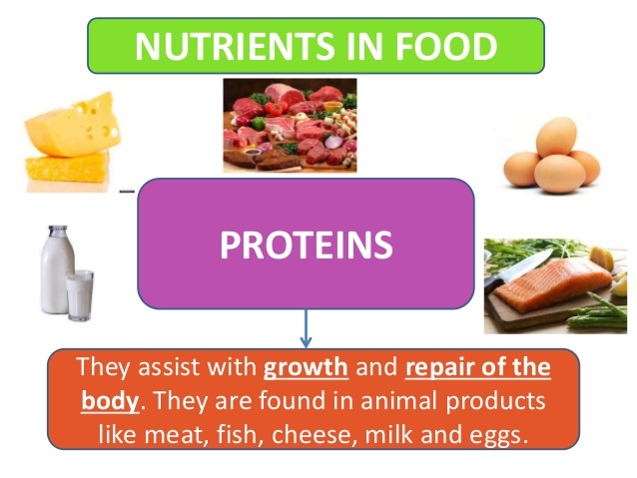
Notes:
9

Slide 10
Fats
Key points
The name fat may make it sound like something you shouldn't eat. But fat is an important part of a healthy diet. Fat from your diet gives you energy. As a bonus, fat in food helps you feel full, so you don't eat too much.
The fats are found in meat and other animal products , and in sweets. Saturated fats are also in palm and coconut oils, which are often used in baked goods you buy at the store.
Eating too much saturated fat can raise blood cholesterol levels and increase the chance of getting heart disease.
-
Notes:
10

Slide 11

Notes:
11

Slide 12
Vitamins
Key points
Vitamins are nutrients required by the body in small amounts,
for a variety of essential processes.
Most vitamins cannot be made by the body, so they need to be provided in our diet.
Vitamin D can be made by the body in the skin when it is
exposed to sunlight.
-
- Vitamins are grouped into fat-soluble vitamins and water-
soluble vitamins.
- Requirements for vitamins change across life stages.
Notes:
12

Slide 13
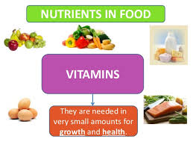

Slide 14
Minerals
Key points
Minerals, like vitamins, play an essential role in the
maintenance of your body’s metabolic functions and
growth.
Some minerals, like calcium, compose the very
architecture of your body, making up many
structural parts including your fingernails, your
teeth and your skeleton and bones.
Other minerals have the important job of helping to regulate your heartbeat, making hormones and triggering enzymatic reactions throughout the body.
Notes:
14

Slide 15
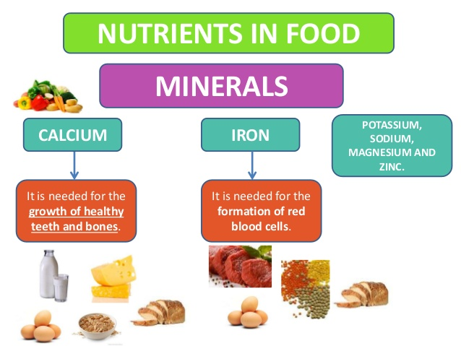
Notes:
15

Slide 16

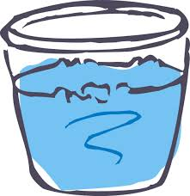
Water: the forgotten nutrient
Drink more water!
Notes:
16

Slide 17
Water
Key points
Water is the body’s most essential nutrient, vital to every body function
It makes up about 70% of our body
It carries nutrients and waste throughout the body
It regulates body temperature
It protects body organs and tissues
It lubricates joints
Notes:
17

