Slide 1
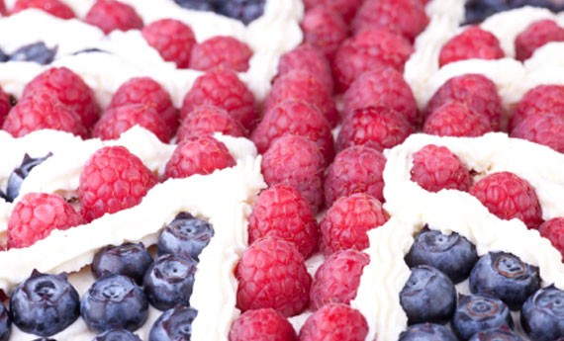
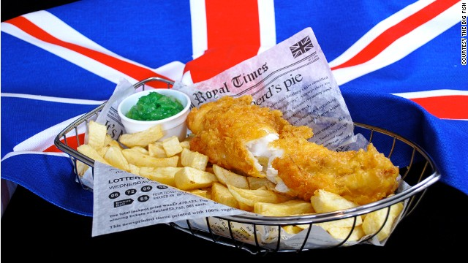
E N G L I S H F O O D

Slide 2
ENGLISH CUISINE
English cuisine includes many styles, traditions and recipes. It has distinctive attributes of its own, but also shares much with wider British Cuisine .
Traditional meals have ancient origins: the 14th-century English cookbook, the Forme of Cury, contains imaginative and sophisticated recipes which date back to the royal court of Richard II. English cooking has been influenced by foreign ingredients and cooking styles since the Middle Ages. Clarissa Dickson Wright in her “A History of English Food” writes that mediaeval dishes often had the texture of a pureé, possibly containing small fragments of meat or fish. These dishes could be broadly of three types: somewhat acid, with wine, vinegar, and spices in the sauce, thickened with bread; sweet and sour, with sugar and vinegar; and sweet, using then-expensive sugar.

Slide 3
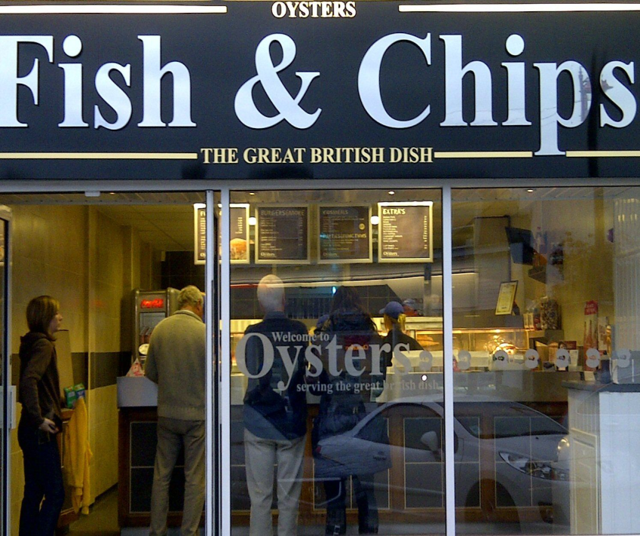
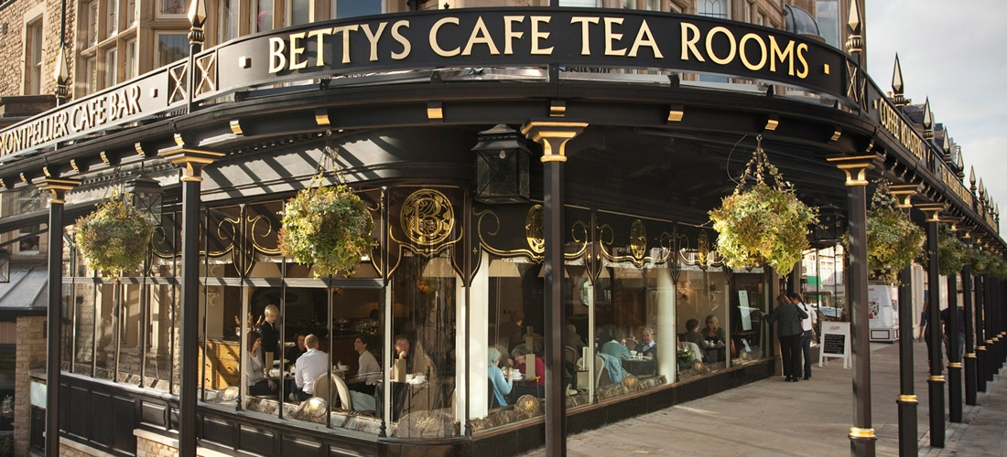
FOOD ESTABLISHMENTS
CAFES AND TEA SHOPS
FISH AND CHIPS SHOPS
The English cafe is a small, inexpensive eating place, where full English breakfast is available all day. Traditional cafes have declined with the rise of fast-food chains, but remain numerous all over the UK . The tea shop is a small restaurant that serves soft drinks and light meals.
Fish and chips is a hot dish consisting of battered fish, and chips. It is a common take-away food. Fish and chip shops in the 1920s were often run by Jews or Italians. Despite this, the new dish was popularly attributed to France.

Slide 4
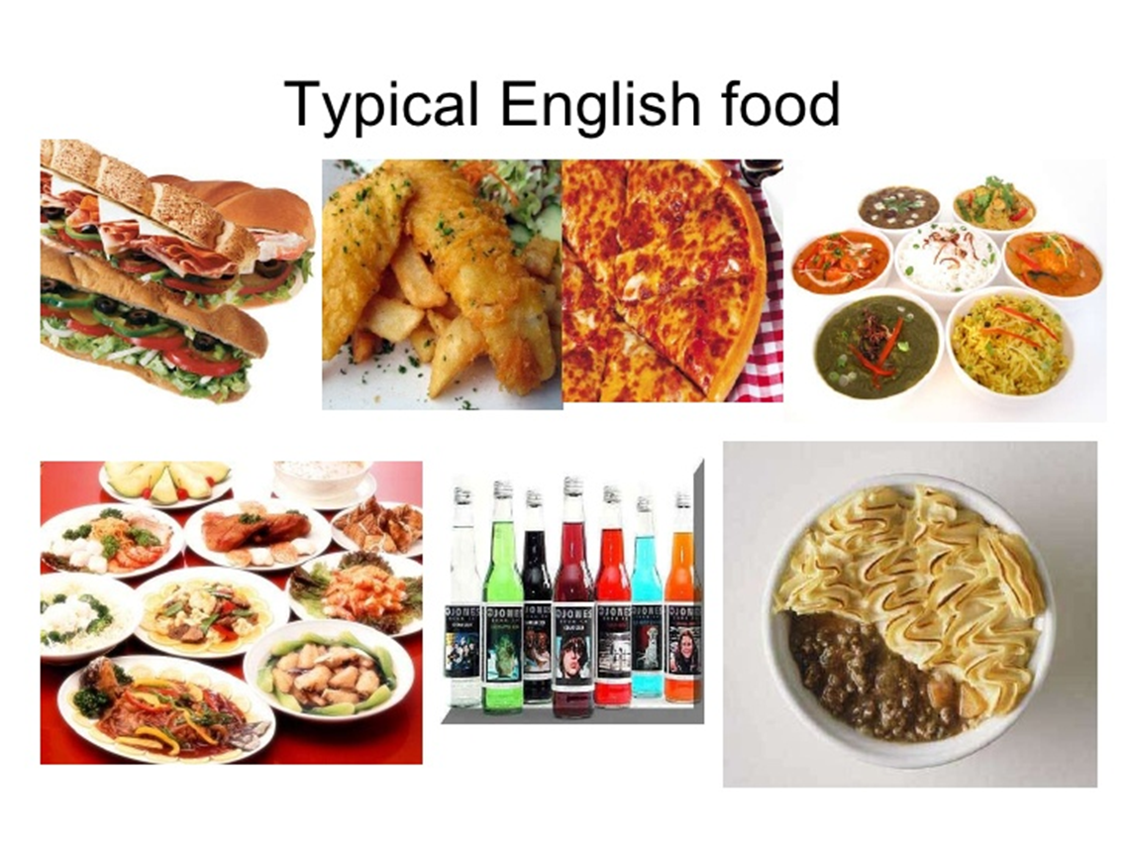

Slide 5
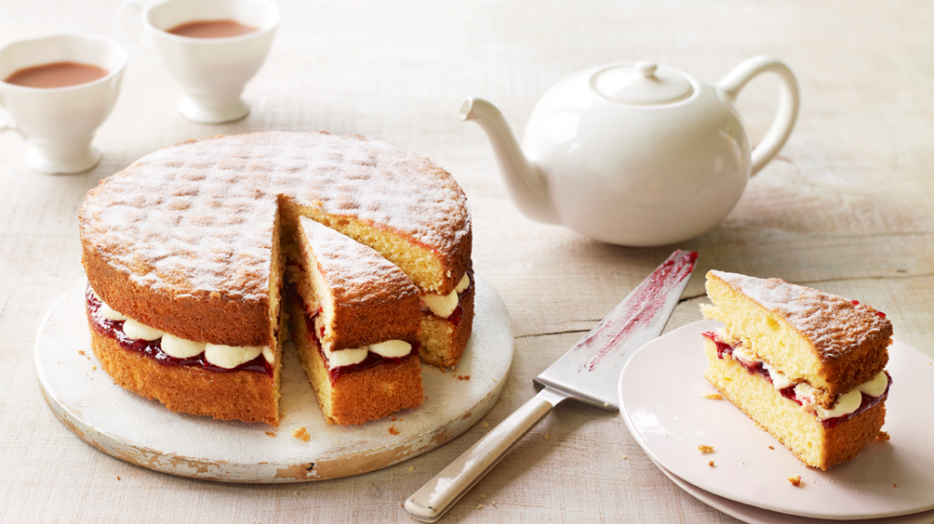
V I C T O R I A S A N D W I C H
The Victoria sandwich is a perfect end-of-meal dessert, easy to prepare, that really fits all needs. In fact you can think of serving this cake to end an important meal, for a buffet in the open air,
its fresh taste makes it a perfect summer dessert, or to offer a different snack, tasty and inviting. The Victoria sandwich is very popular in the United States, too

Slide 6
H I S T O R Y
- The Victoria sandwich is a traditional dessert of English origin, a soft and moist cake, the sponge cake, and a delicious filling of cream cheese and raspberry jam. Its unforgettable contrast of colors and flavors has helped make this cake a true masterpiece of confectionery, a classic recipe that resists over time rising even more traditional sweets .
- The Victoria sandwich was made famous by Queen Victoria, who appreciated its taste to the point of making it her favorite cake to accompany the classic and 5 o'clock tea! And it is in honor of the queen that the cake, with its classic sandwich shape, takes its name.

Slide 7
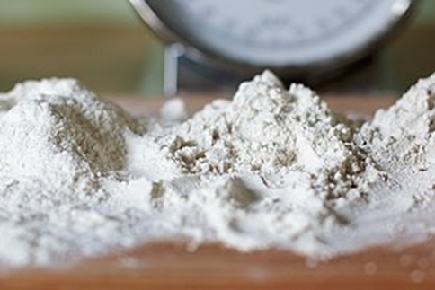
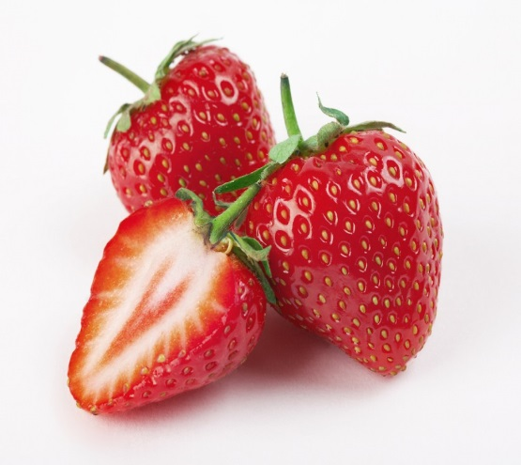
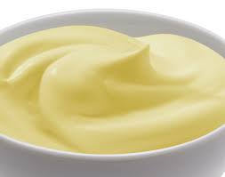
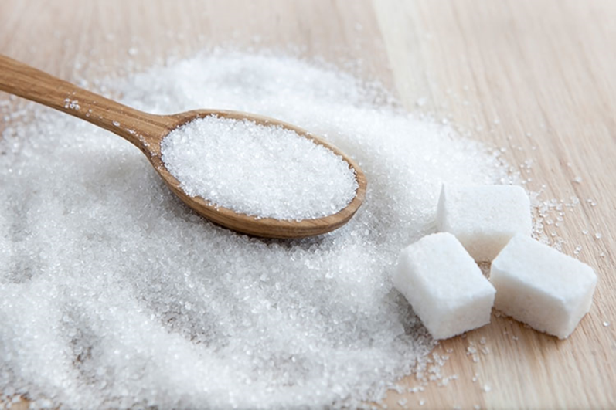
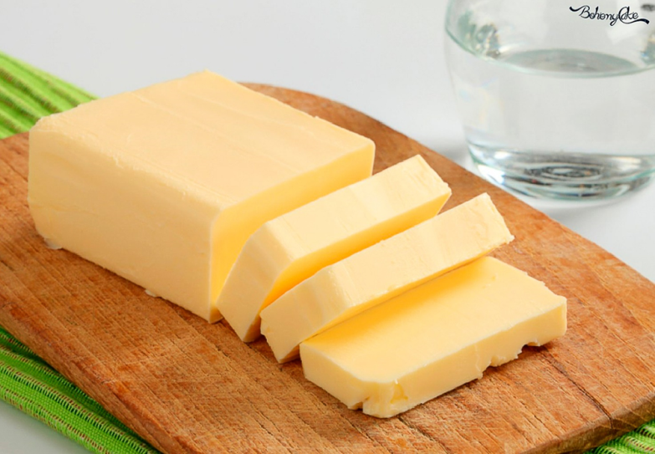
INGREDIENTS
- 200 grams of 00 flour
- 200 grams of sugar
- 200 grams of butter
- 4 eggs
- 50 ml of milk
- 10 grams of baking powder
(1 teaspoon )
To stuff :
- 300 gr of Philadelphia
- 200 ml of cream for cakes
- 2 tablespoons of icing sugar
- 1/2 teaspoon of vanilla essence
- 300 gr of raspberry jam
- 125 grams of raspberries (fresh)
- 1 pinch of salt

Slide 8
M E T H O D
Step 1
Work the butter with the sugar until it is creamy. Add an egg, vanilla extract , flour with baking powder and 1/2 tablespoons of milk.
Step 2
Bake the cakes for 30 minutes , then keep it in the fridge for 1 day .
Step 3
- Whip the cream with the icing sugar.
- Cut the strawberries.
- Take a base and fill it with a layer of cream then cover with jam and
strawberries.
- Add the other base, decorate it , with strawberry slices and icing
sugar.

Slide 9
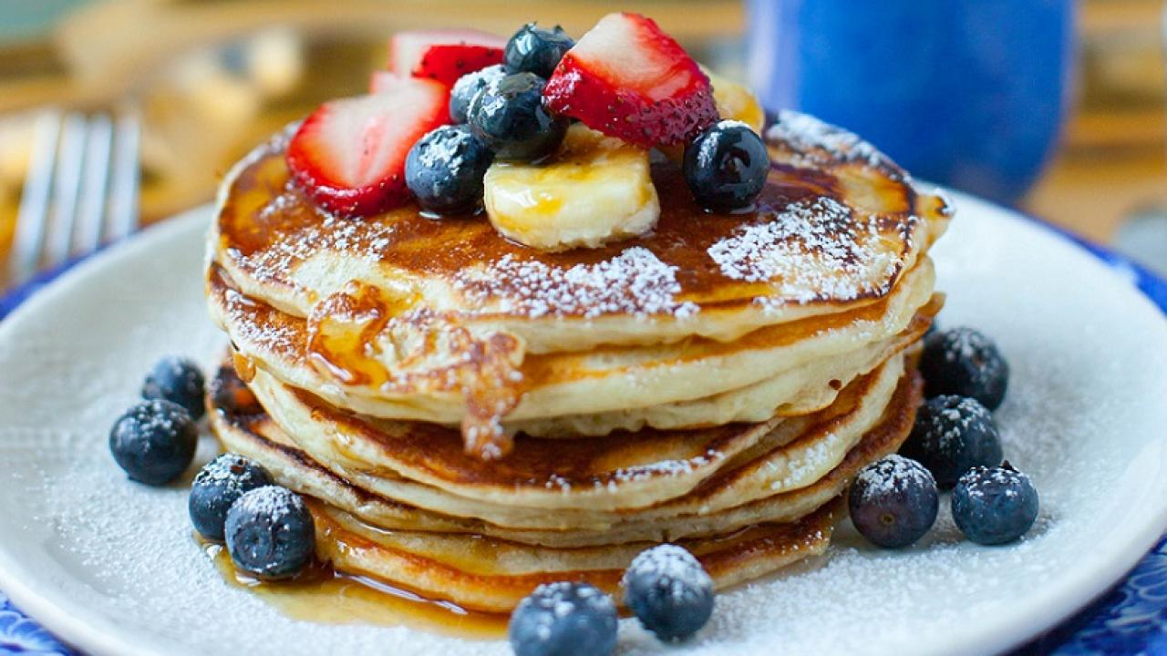
P A N C A K E

Slide 10
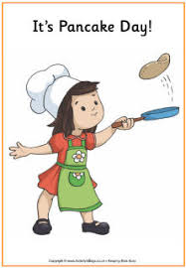
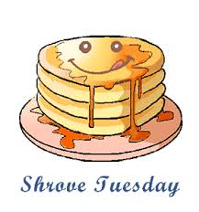
H I S T O R Y
Pancake day , is on Shrove Tuesday . It’s a fun day in Britan , like carnival in other countries. It is a way to use up all the eggs in your house the day before the 40 days of Lent start. You can have lots of different fillings in your pancakes. Lemon , chocolate, banana and honey are popular sweet fillings.
Or how about savoury things like cheese and ham ?
But people don’t just eat pancakes on Pancake Day: some people race with
their pans and toss their pancakes at the same time!
Sometimes they wear silly hats or costumes, too.

Slide 11
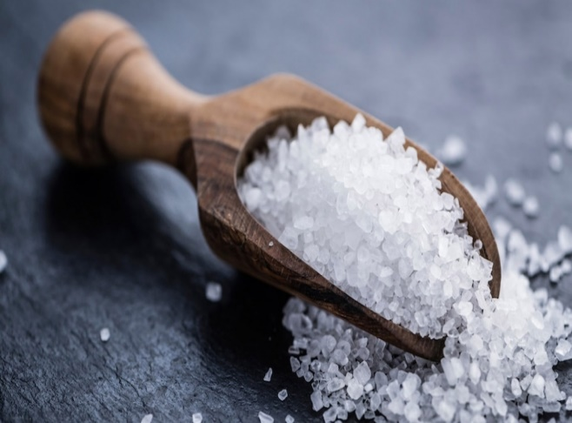
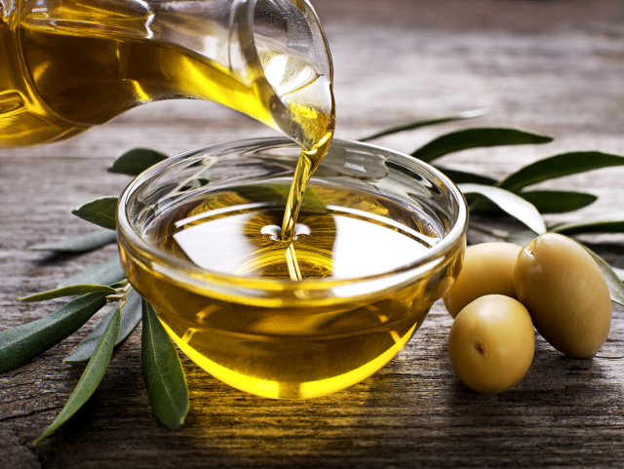
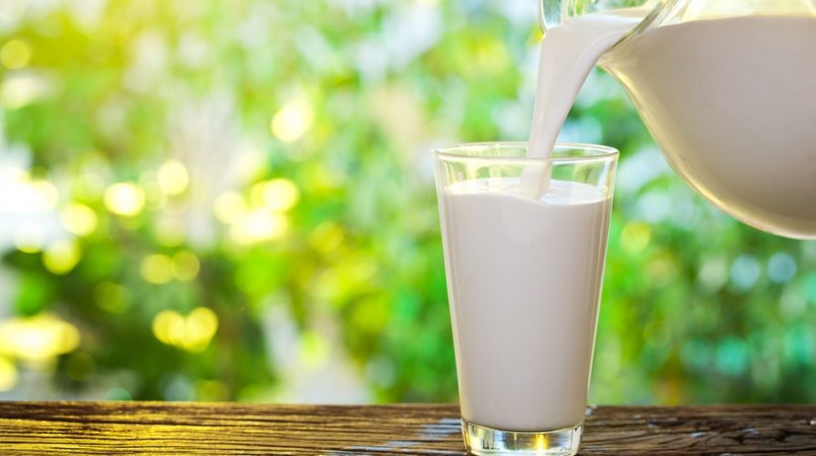
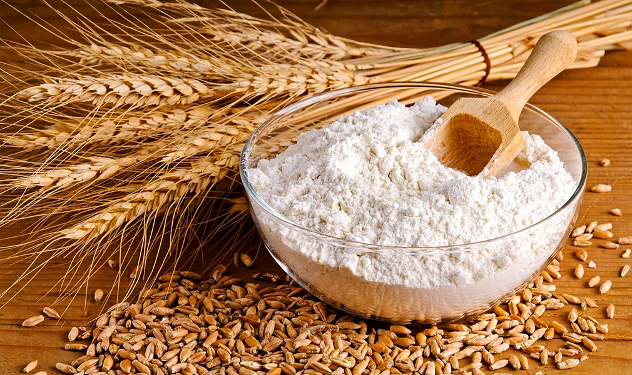
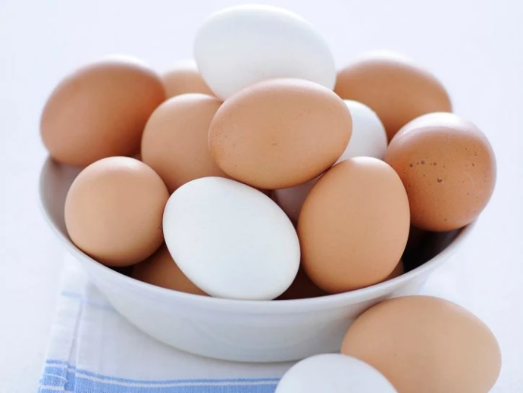
I N G R E D I E N T S
100 g flour
2 eggs
300 ml milk
1 tablespoon of oil
A little salt

Slide 12
M E T H O D
Step 1
Mix the eggs , flour , salt and milk in a bowl .
Step 2
Heat the oil in a pan.
Step 3
Put some pancake , mixture in the pan .
Step 4
After a minute , toss the pancake and cook the other side
Step 5
Add the fillings
Step 6
My favourites are sugar and lemon . Yum !

Slide 13
By:
ANTONELLI FEDERICO
BORDACCHINI DESIREE
PETTINELLI AURORA
PROIETTI EDOARDO
ROSATELLI DESIREE

