Slide 1
Black bun
Scottish food
Notes:
1

Slide 2
History of the black bun
Black bun is a type of fruit cake completely covered with pastry. It is Scottish in origin, originally eaten on Twelfth Night( the 20th night before Christmas) but now enjoyed at Hogmany (a Scottish festival, the last day of the year).
Notes:
2

Slide 3
Ingredients
200g plain flour, plus extra for dusting
200g raisins
400g currants
1 tsp ground mixed spice
1 tsp ground ginger
75g dark muscovado sugar
100g chopped mixed peel
½ tsp bicarbonate of soda
1 tbsp brandy or whisky
1 egg, lightly beaten
3 tbsp milk
A generous pinch of freshly ground black pepper
Notes:
3

Slide 4
Method
Make the pastry. Put the flour, baking powder and a pinch of salt in a large bowl. Add the butter and shortening and rub in until it resembles breadcrumbs. Stir in 4 tablespoons of cold water and mix to a soft dough. Cover with cling film and chill while you make the filling.
Preheat the oven to 180°C/ fan160°C/gas 4. Mix all the filling ingredients together in a large bowl, with enough milk to just moisten it.
Dust a clean work surface with flour. Roll out three-quarters of the dough to a rectangle large enough to line the base and sides of a 900g loaf tin. Drape into the tin and press up against sides, smoothing out any creases. Tightly pack in the filling and press down well. Roll out the remaining pastry to a rectangle large enough to fit the top. Dampen the edge of the pastry in the tin with water, press the pastry lid on top to seal and trim off the edges. Bake for 2 hours. Allow to cool for 1 hour.
Remove the black bun from the baking tin, then cut into slices to serve.
Notes:
4

Slide 5
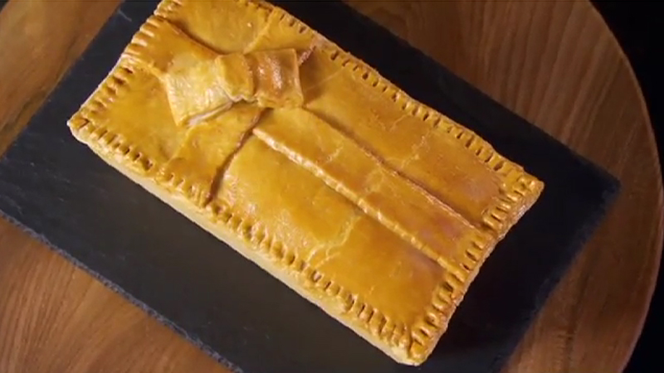
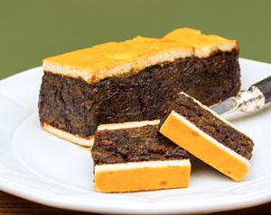
Notes:
5

Slide 6
By:
Tabata Bolotta
Amon Fulvi
Erika Pannacci
Notes:
6

