Slide 1
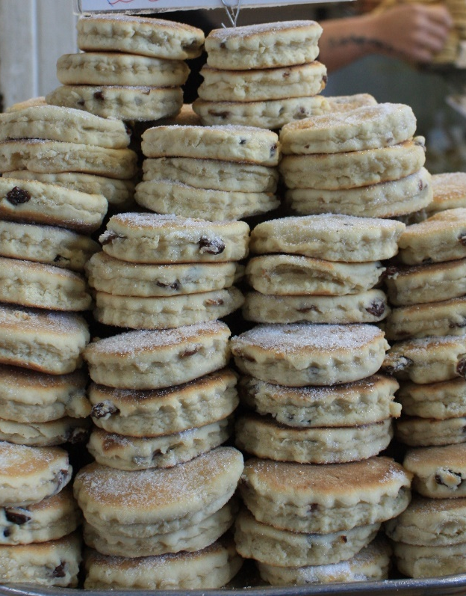
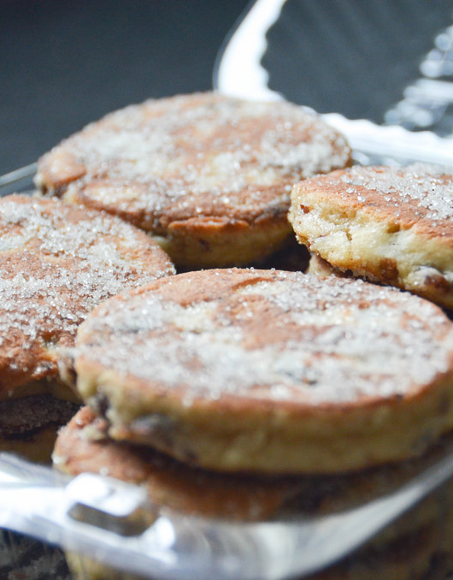
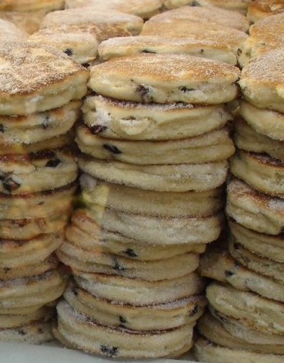
Welsh Cakes
by: Filippo Cappelloni, Diego Rossi, Giulio Citarei
Notes:
NOTA: per sostituire un'immagine selezionarla ed eliminarla, quindi usare l'icona Inserisci immagine per sostituirla con l'immagine desiderata.

Slide 2

What are the Welsh Cakes?
The cakes are a cross between a biscuit, a muffin and a pancake but they are really different from any of these things.
They are the size of a biscuit, made with ingredients similar to a muffin, but cooked like a pancake on a plate.

Slide 3
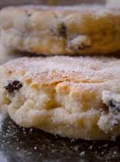
History
Around 1800 the Welsh Cakes (or Welsh cupcakes) began to be produced, usually prepared by Welsh women, who cooked them as a snack to take to school for their children.
As this was a hearty and delicious dessert, it soon became the "snack" par excellence of Welsh miners.
They were made with the right size to fit into the pockets of their work jackets.
The dessert was the only moment of light and joy for the miners forced to do this hard work in the dark.

Slide 4
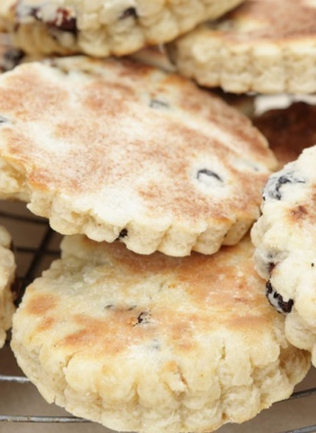
Ingredients
225 g of flour
2 tsp of baking powder
110 g of butter
1 pinch of salt
1 pinch of cinnamon and nutmeg
1 egg
sultanas to taste milk if necessary
85 g of granulated sugar
extra butter to grease

Slide 5
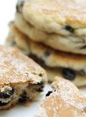
Method
Work the butter and the flour. Add sugar, the baking powder, salt, cinnamon, nutmeg, raisins and egg.
If necessary, use a dash of milk.
Form a soft paste that you can work with your hands. Pull the dough until you get a sheet of 5 millimeters and cut out 7.5-10cm with a pastry cutter (the wavy one).
Preheat a heavy iron plate or non-stick pan.
Grease with the butter and cook the desserts on the plate, about 2-3 minutes per side, each of which must be caramelized, thus assuming a slightly amber color.
Remove from the pan and sprinkle with granulated sugar when they are still hot.
They are also excellent with jam.

