Slide 1
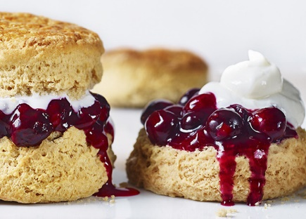
Scones
Notes:
1

Slide 2
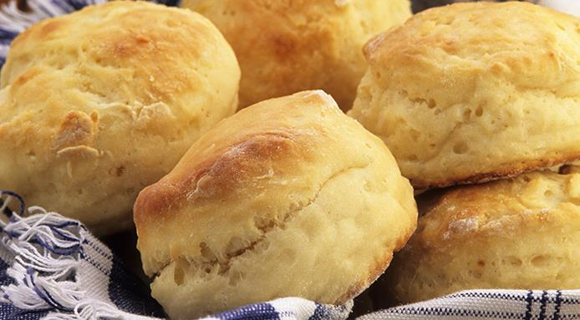
What are Scones?
Scones are popular buns in Ireland. The preparation of scones is very easy. These sweet milk rolls are traditionally consumed with tea, often filled with butter and jam at the time. They are the typical sweets of St. Patrick
Notes:
2

Slide 3
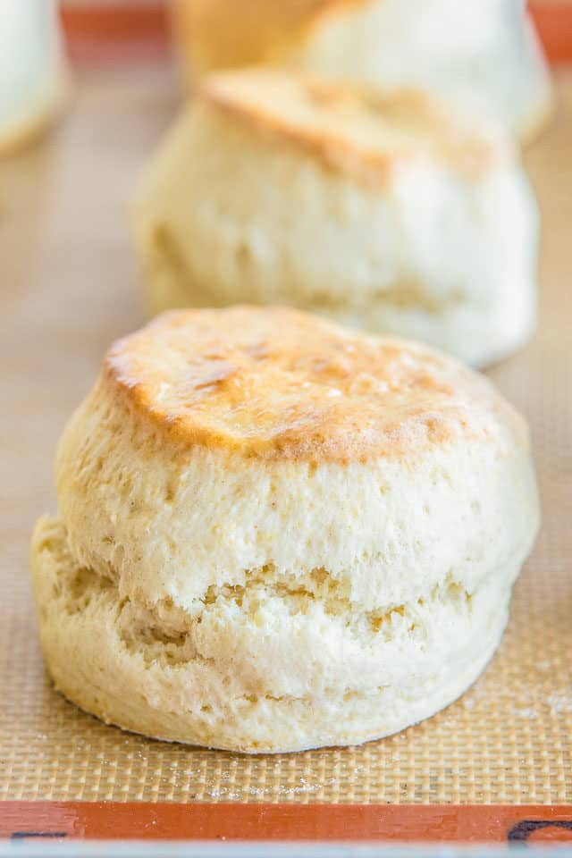
Ingredients:
200 grams of 00 flour
1 teaspoon baking powder
100 ml of milk
1 tablespoon of granulated sugar
50 grams of butter
1 pinch of salt
Notes:
3

Slide 4
Method
Mix flour, sugar, baking powder and salt to form the classic fountain
Add the butter at room temperature, and immediately after the milk
Knead by hand until a smooth paste is obtained
Let the dough rest in the fridge for about a quarter of an hour
From the dough, obtain the same "balls", flatten them with your hands and place them on a baking sheet
Bake at 200 degrees for at least a quarter of an hour
Notes:
4

Slide 5
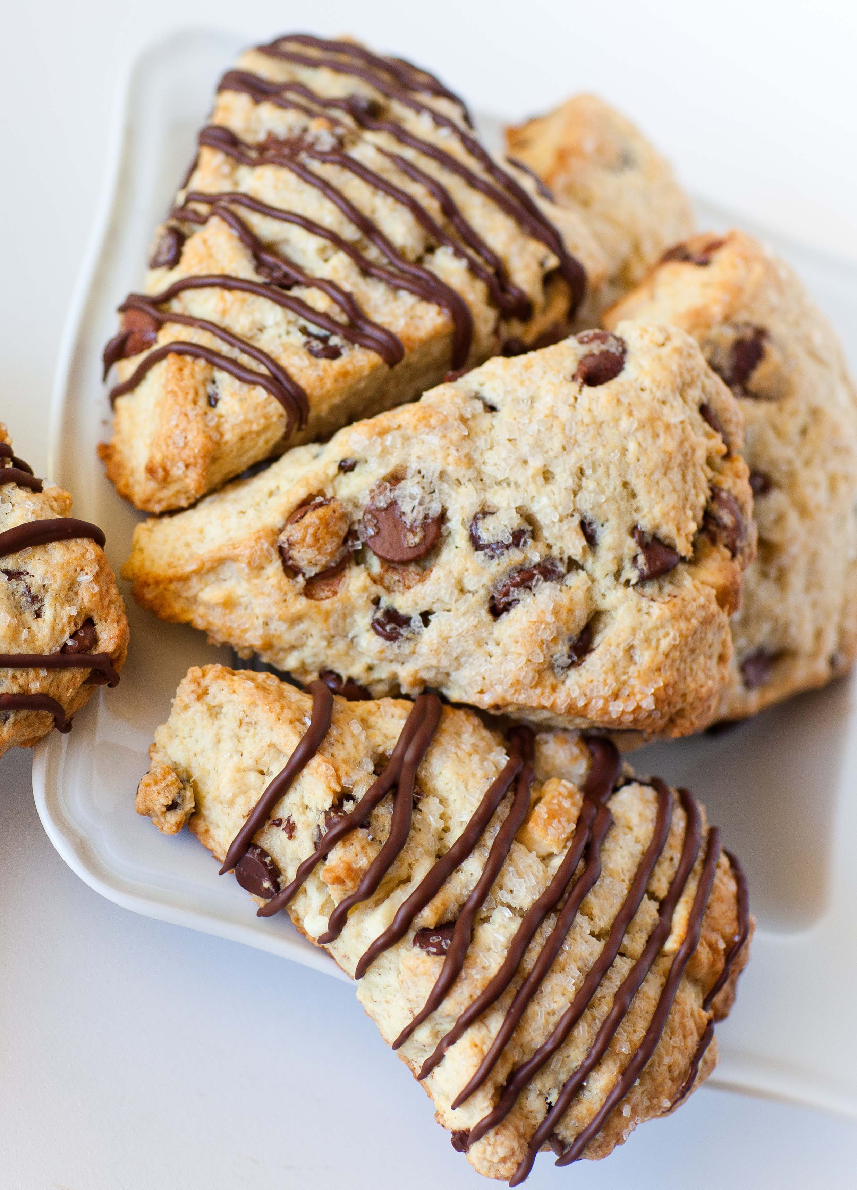
Curiosities
- Where does the name scones come from?
They were born as “Schoonbrot”: shoonbrot literally meant
beautiful (schoon) bread (brot)
- What are the scones used for?
They are served with jam and clotted cream to accompany tea
- What shape do scones have?
Originally the scone block was laid out to give it a round shape, called
bannock. The bannock was divided into 4-6 triangular-shaped segments.
Notes:
5

Slide 6
By: Alice Massarelli,Valeria Leonardi,Agnese Scalpello and Elisa Massimi
Notes:
6

